Slide 1
Refraction of Light

Slide 2
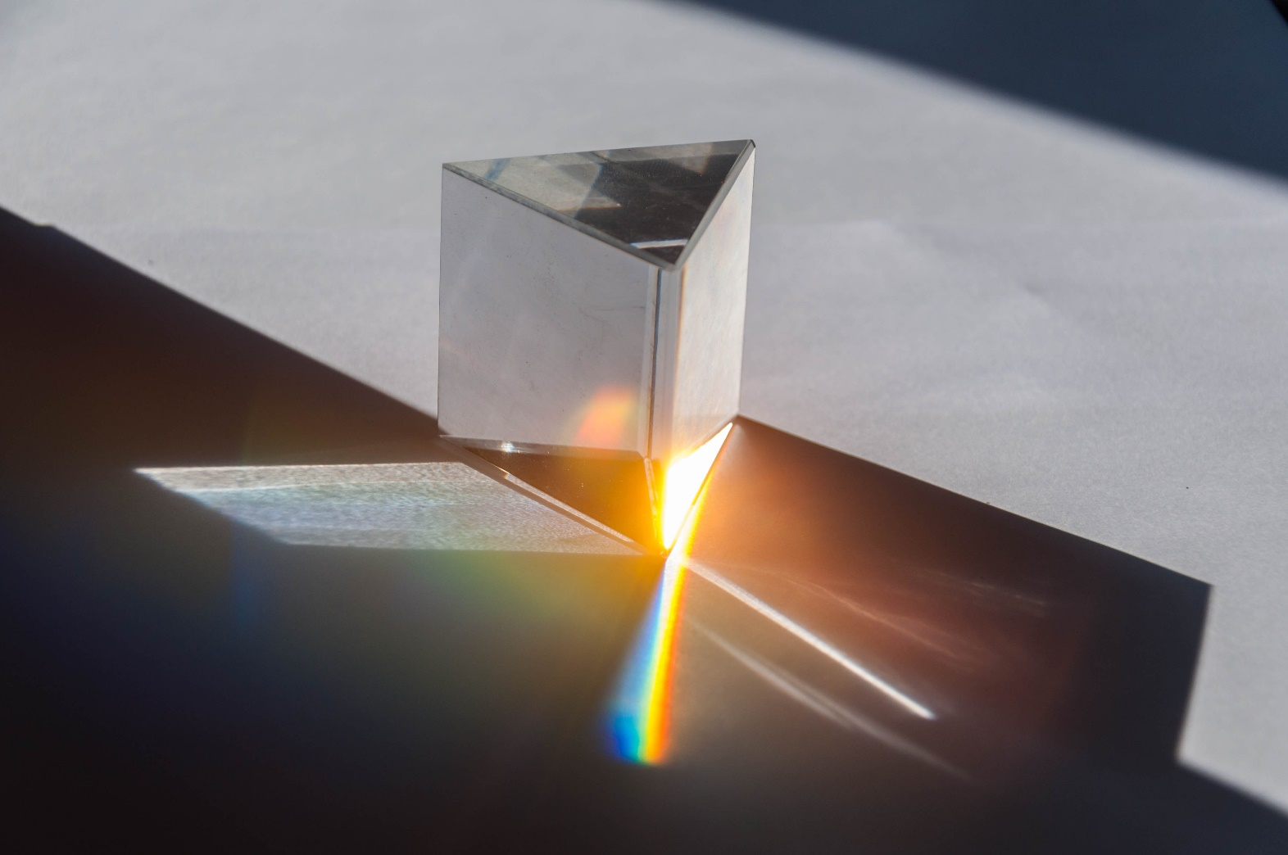
By the end of this lesson, you should be able to:
Describe the refraction of light as it changes between different mediums.
State the relationship between refractive index and the speed of light in the medium.
Explain the dispersion of white light.

Slide 3
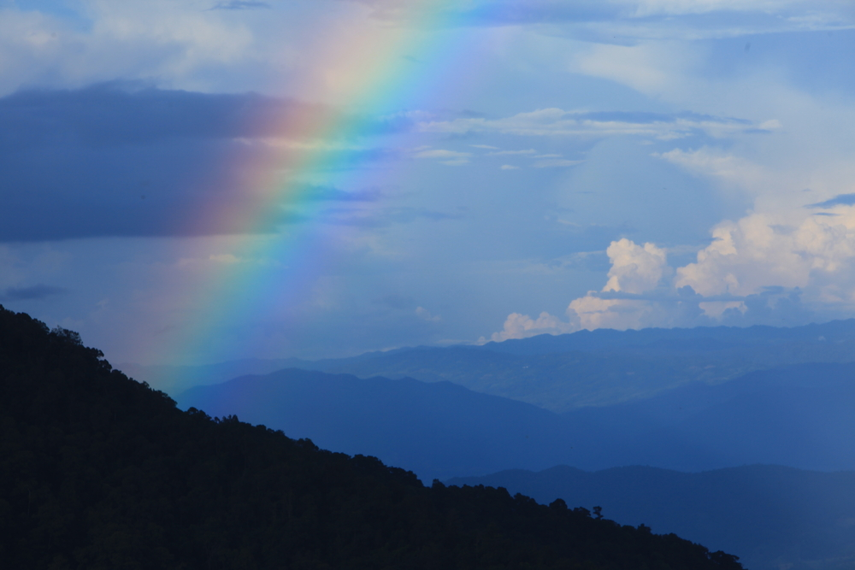
You might not think of it, but the refraction of light has many applications in everyday life.
Have you ever been to a swimming pool, and noticed that people swimming under the water seem to be in a different position than they actually are? Or put a straw in a glass of water and seen it appear to bend? That’s refraction.
Refraction enables optical lenses such as glasses, binoculars and microscopes to function. It is also responsible for natural phenomena such as rainbows and mirages.

Slide 4
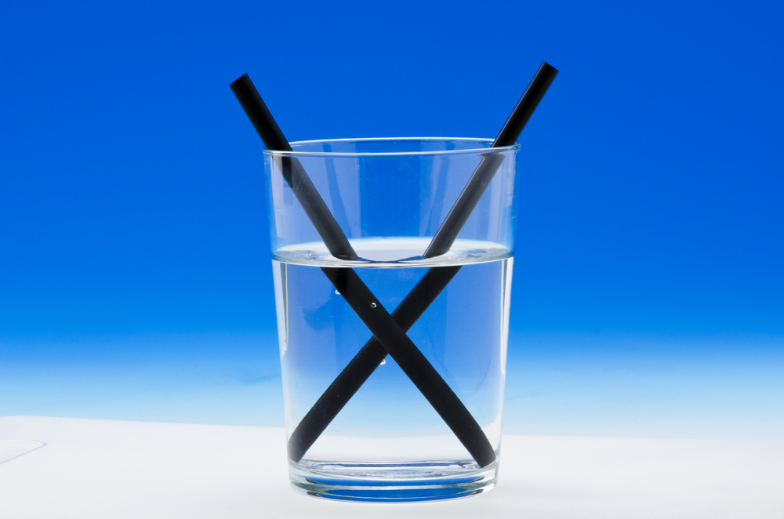
Light will bend as it changes mediums.
A medium in this context is any substance through which light can travel. A change in medium could involve light passing from air to glass, or water, or crystal—or going in the other direction (i.e. from water to air).
You can see an obvious example of this when you place a straw in a glass of water. The submerged part of the straw appears disconnected from the top. What you are seeing is refraction. The light reflected from the straw bends a different amount when it passes from water to glass compared to when it passes from glass to air. Thus, the bottom of the straw seems to be at a different angle to the top.

Slide 5
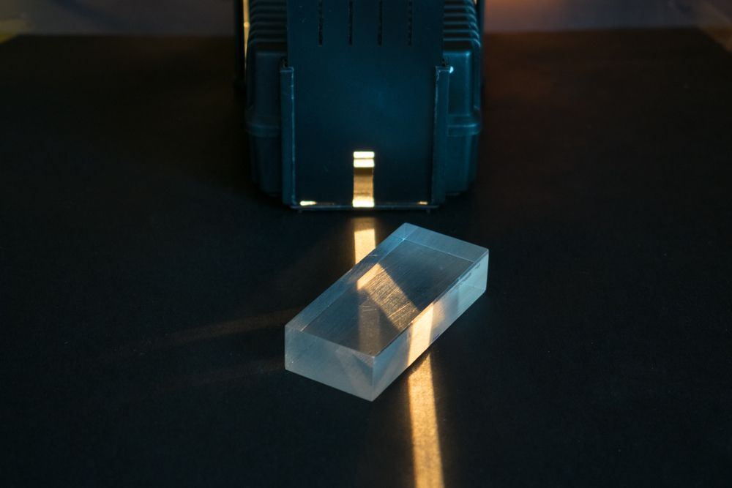
Refraction is caused by a change in the speed of light.
We often talk about the speed of light as being 3.00×108 m s−1, however light only travels at 3.00×108 m s−1 in a vacuum. If light travels through a medium, it travels slower. The speed of light is different for each medium light travels through, but it is always less than the speed of light in a vacuum. For example, the speed of light in water is only 2.25×108 m s−1.

Slide 6
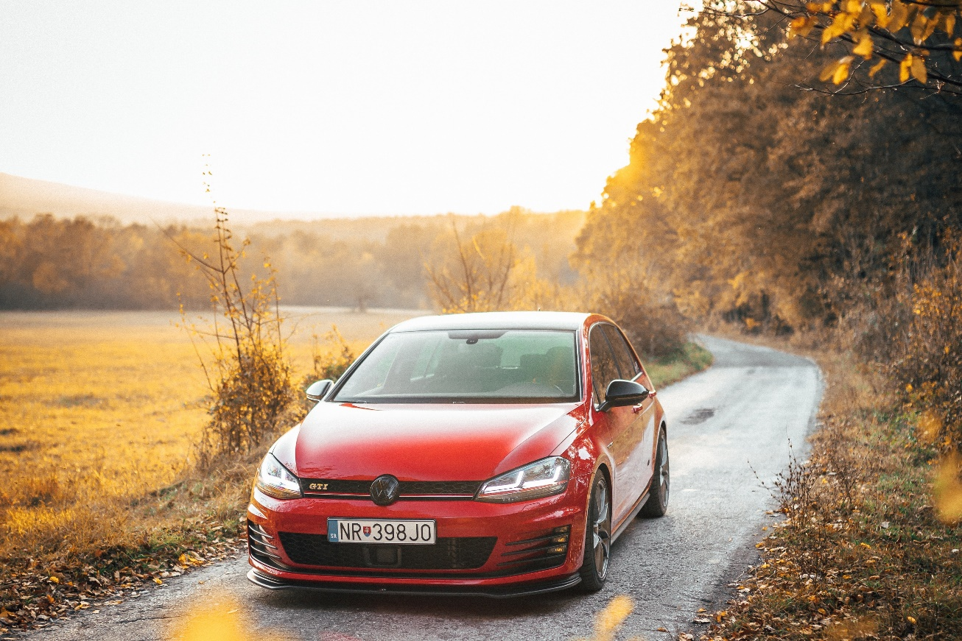
As an analogy, imagine a car driving from concrete onto sand.
Sand is harder to drive on than concrete, so it slows the car down. If the car drives in a straight line from one to the other, it will slow down but not change direction.
Remember, the normal is the line perpendicular to the boundary between two mediums. The car, then, is travelling parallel to the normal.

Slide 7
Something different happens if the car drives onto the sand at an angle.
One wheel will hit the sand first, and it will slow down before the rest of the car. The car must remain as one moving object (driving onto a different surface will not make your car fall apart), so the body of the car will rotate around that wheel. Thus, as the car passes onto the sand it will change direction, towards the normal.
When the car drives back from sand onto concrete, the opposite will occur. One wheel will speed up before the others, and the car will rotate back in the other direction.

Slide 8
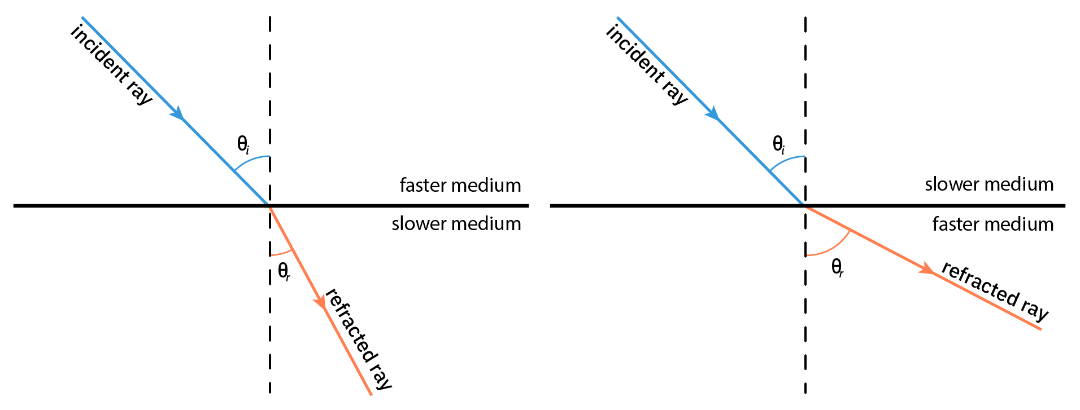
In the same way as the car, the direction in which light bends depends on whether it slows down or speeds up.
When light changes mediums and slows down, it will bend towards the normal. When light changes mediums and speeds up, it will bend away from the normal.
Refraction only occurs if light hits the boundary of a medium with an angle of incidence that is greater than 0∘. If the incident ray travels parallel to the normal (as when the car drives straight at the sand), no refraction will occur and the light ray will not bend.

Slide 9
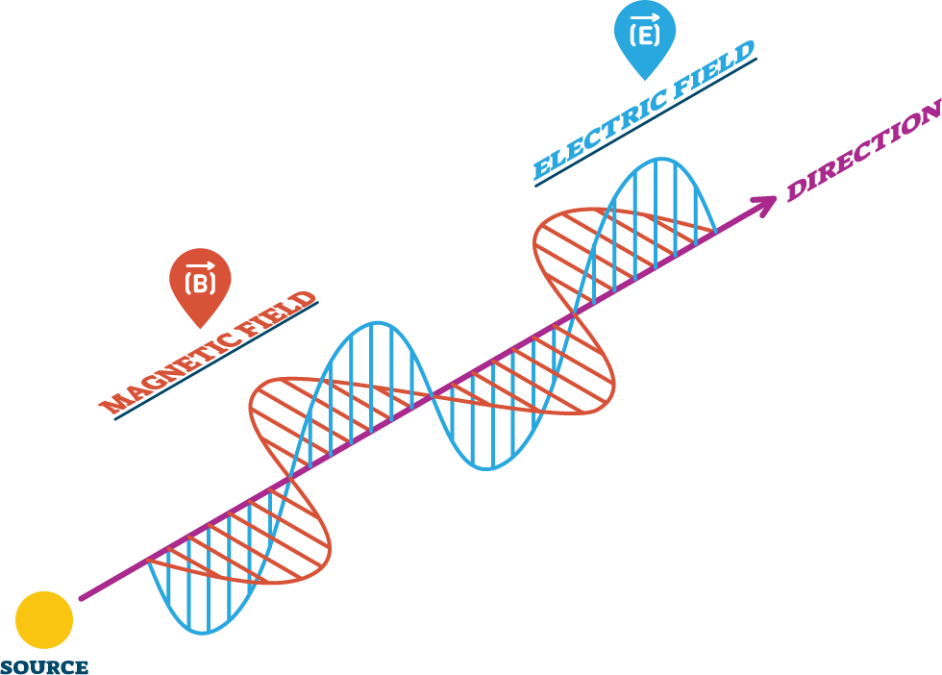
As light changes mediums the frequency of the light remains constant.
But what happens to the wavelength? We know from the wave equation that v=fλ; if the speed is changing but the frequency is constant then the wavelength of light must change!
This means that as the speed decreases, the wavelength also decreases. Or as the speed increases, the wavelength also increases.

Slide 10
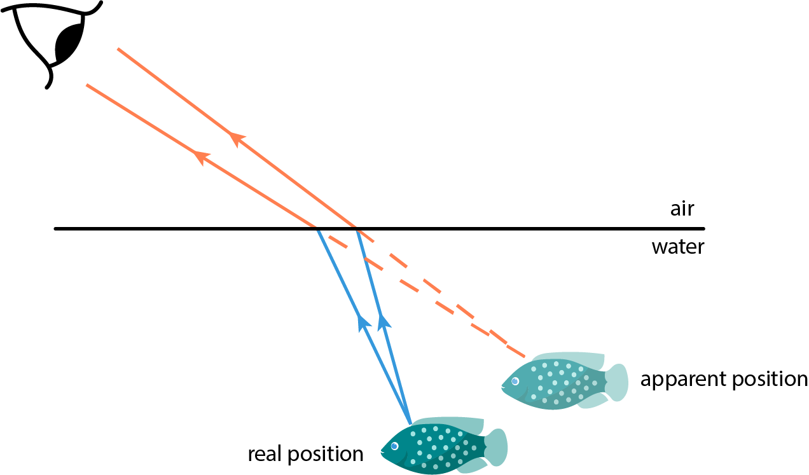
A striking example of refraction is the position of objects underwater.
If you look at a fish from the air above its pond, its true position is deeper than it appears to you. The light rays reflected from the fish speed up as they pass from water to air, so they refract (bend) away from the normal.
This means that the rays reach your eyes at a shallower angle than they left the fish. Your eyes interpret this angle as its true position. If you then try to catch the fish, you might be surprised to find that it is not where you thought it was.

Slide 11
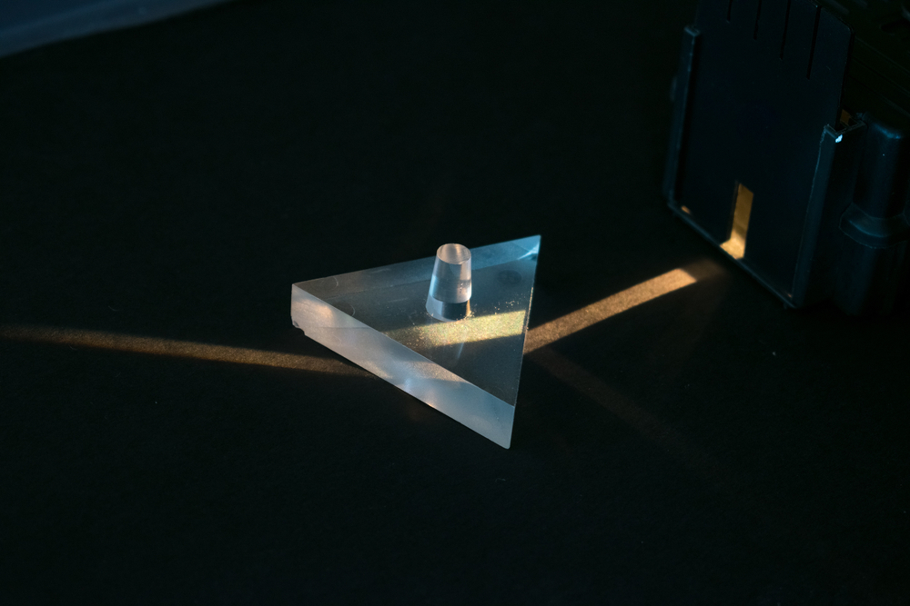
So, how can we predict which way light will refract?
The absolute refractive index (denoted by n) is a measure of how much light is slowed down by a material, relative to its speed in a vacuum. This means the refractive index is a ratio and doesn’t have a unit!
The speed of light is highest in vacuum. Every material slows light down. Thus, vacuum is used as the standard by which every other refractive index is calculated. The absolute refractive index of a vacuum is 1, since the speed of light in a vacuum relative to the vacuum is the same.

Slide 12
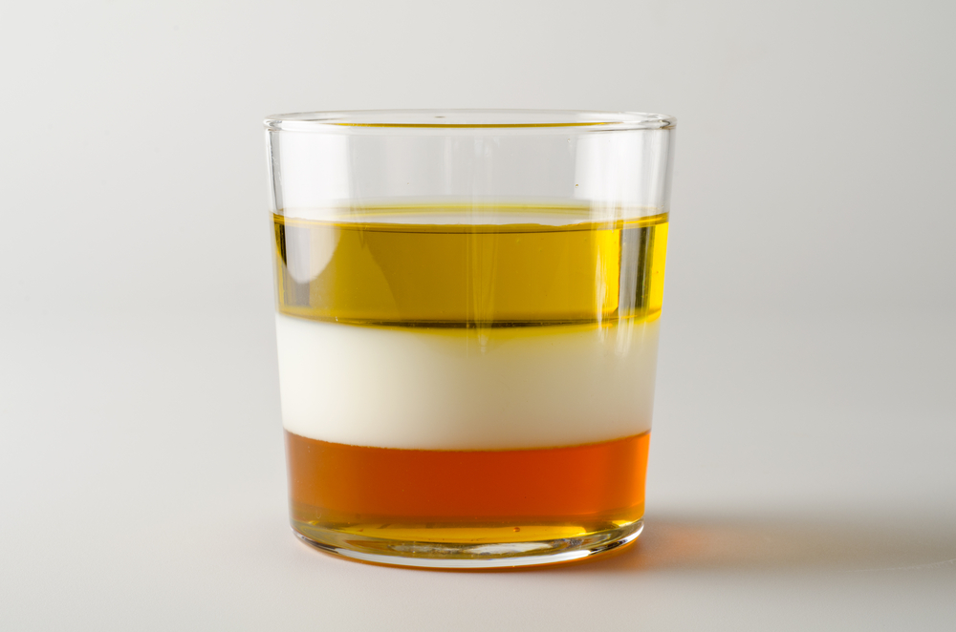
The amount that light is slowed down depends on the density of the material; a denser medium will slow light down more than a less dense one.
A medium with higher density (and a higher refractive index) than the medium the light comes from will slow light down, and it will bend towards the normal. A medium with lower density (lower refractive index) will speed light up, and it will bend away from the normal.
However, light will always slow down as it enters a medium from vacuum, thus the refractive index of a material is always greater than 1. Since a vacuum has the lowest possible density (and thus the highest possible speed of light), light always slows down when leaving a vacuum.

Slide 13
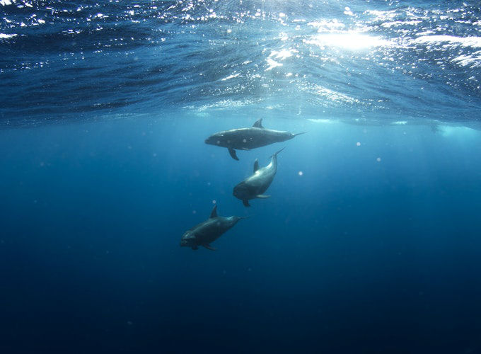
Historically, scientists couldn’t measure the speed of light in different mediums.
However, they could still use refractive indices. Any given pair of materials will bend light by a different, constant amount. The relative refractive index between the two materials can be calculated from this.
The relative refractive index is the ratio between the speed of light in one material and the speed of light in another, where neither material is a vacuum.
For example, the ratio between water and vacuum is the absolute refractive index of water. The ratio between water and air is the relative refractive index of these two substances.

Slide 14
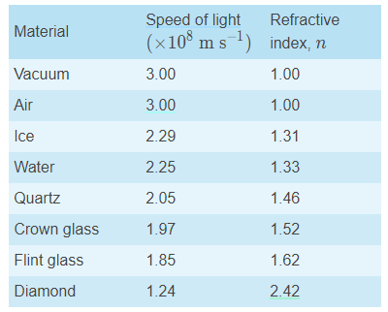
The (absolute) refractive index of a substance depends on its density.
For example, air has a refractive index of 1.0003, as light travels only slightly slower in air than in a vacuum. Using a refractive index (RI) of 1 is sufficiently accurate for most situations.
The table below gives some examples of the speed of light and refractive index of different substances. Note that as RI is a measure of how much light slows down, a slower speed of light correlates to a higher RI. A material through which light travels at half its speed in a vacuum would have an RI of 2.

Slide 15
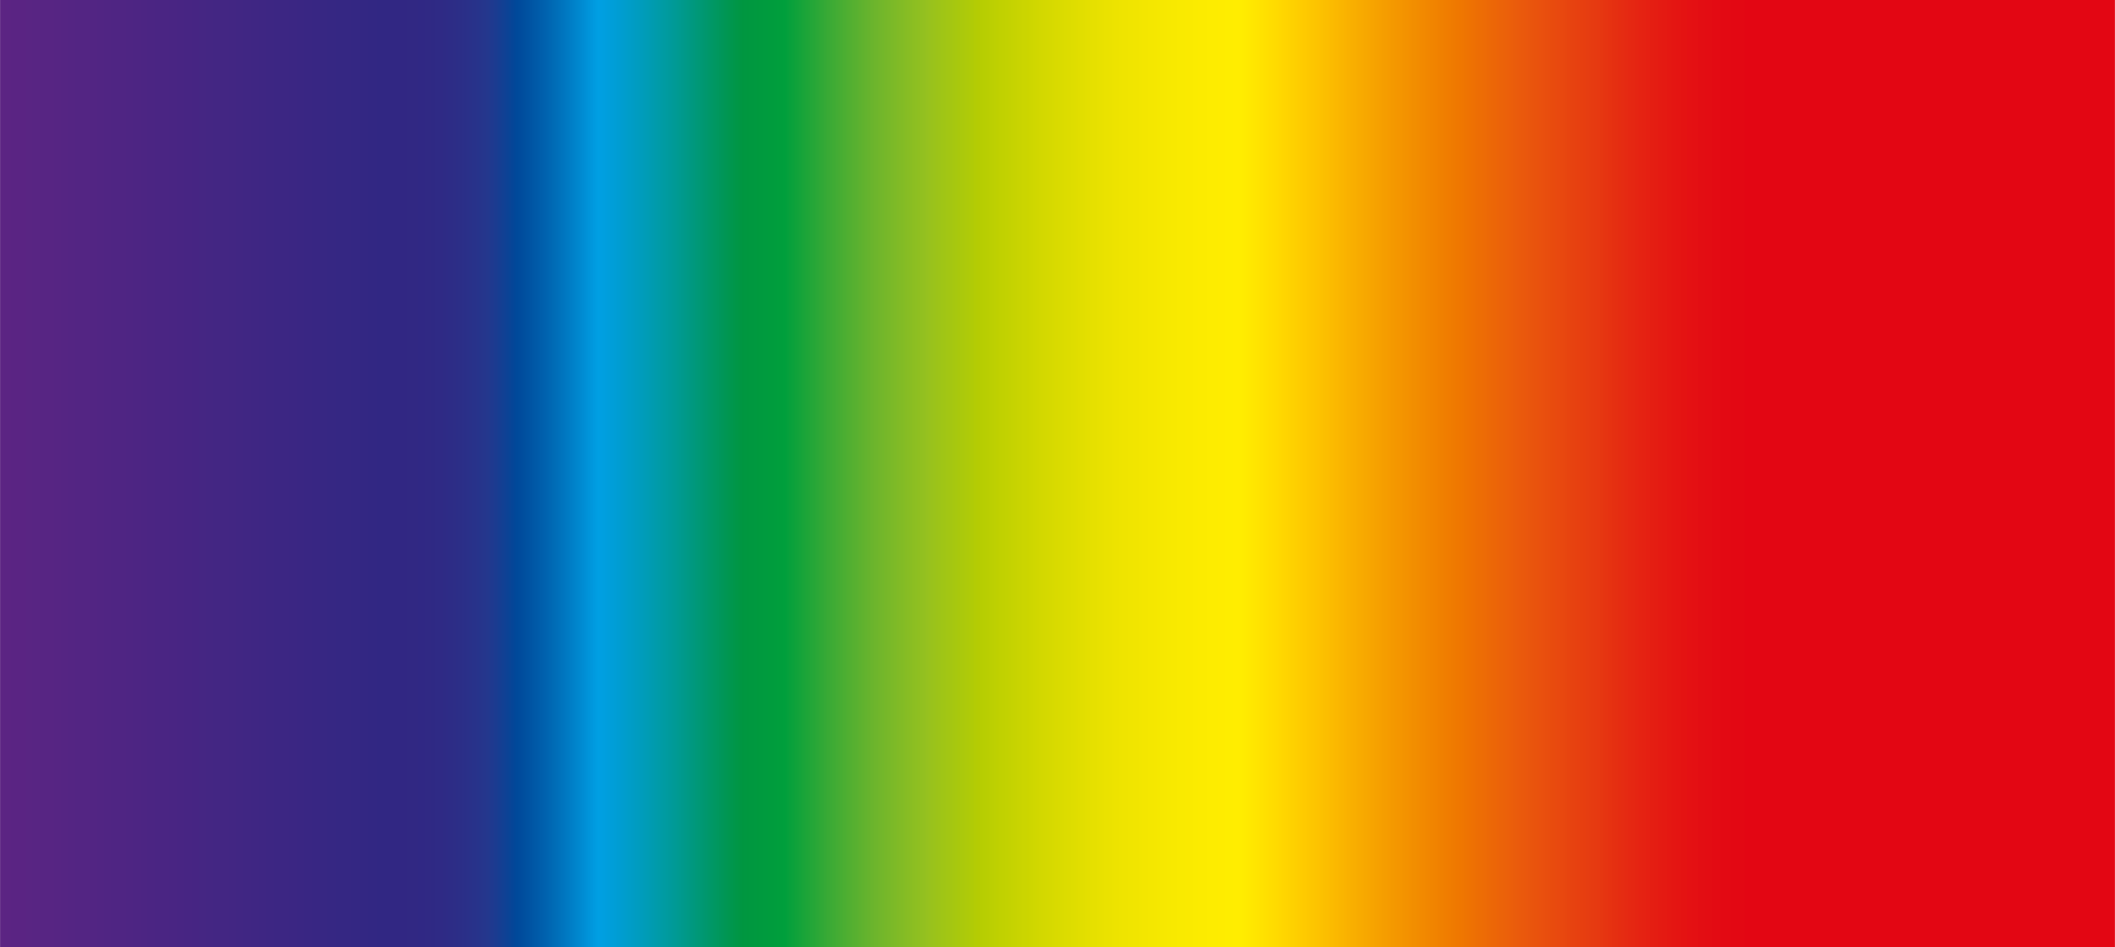
Colours correspond to different wavelengths of light.
The possible wavelengths of light vary continuously, so the colours grade into each other, as you can see in the spectrum below. Red light has the longest wavelength we can see, and violet light has the shortest wavelength we can see.
White light is light that is composed of the whole visible spectrum; white is not a colour, but the mixture of all colours.

Slide 16
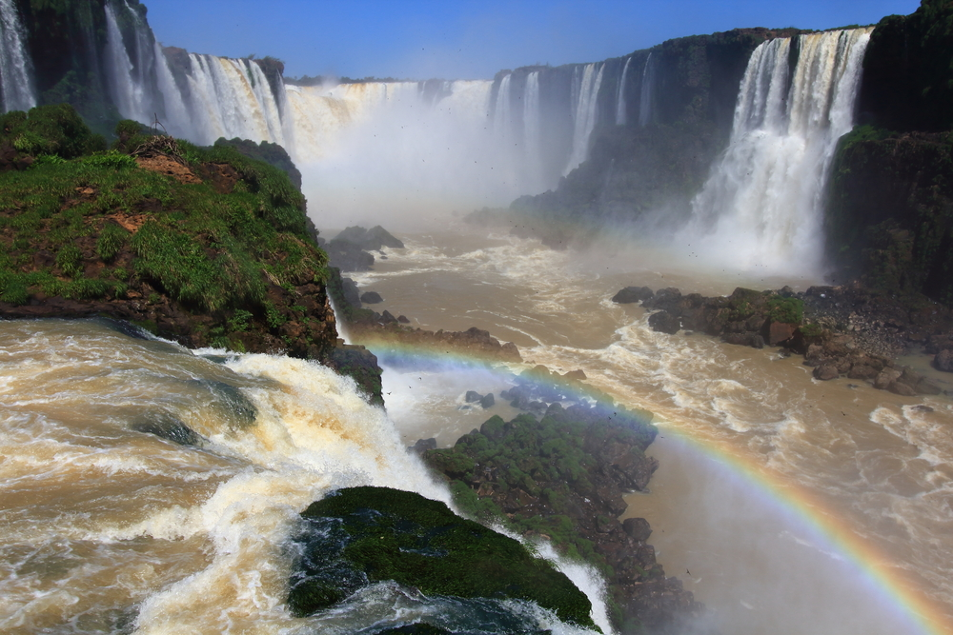
Each colour of light has a different refractive index in a given substance.
This means that if white light is shone into a different medium, each colour will refract at a slightly different angle. These varying angles will cause the light to split into its component colours, producing a spectrum. This is called dispersion.
In most circumstances this effect is very subtle, occasionally visible, for example, as faint rainbows around the edges of a glass. In some instances, though, it can be spectacular.

Slide 17
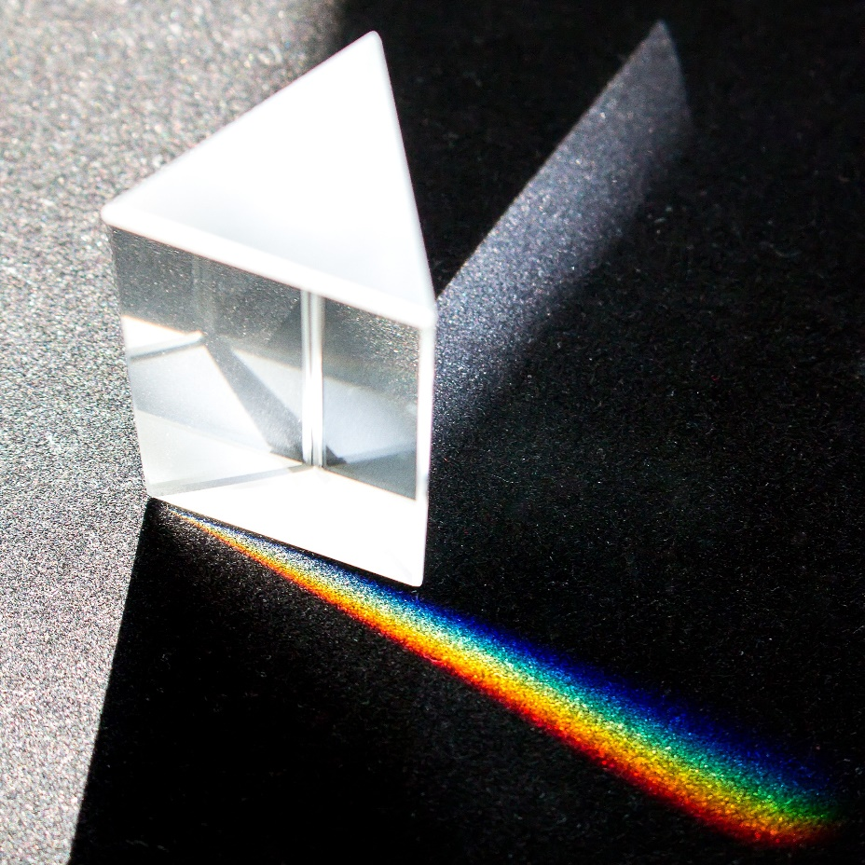
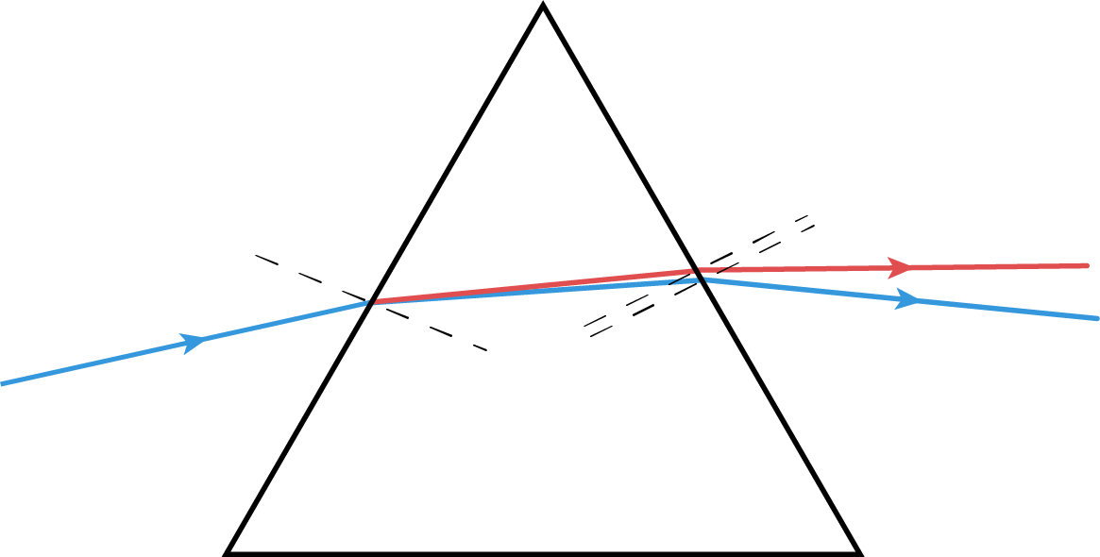
When a narrow beam of white light is pointed at a glass triangular prism, it spreads into a rainbow.
As the light enters the prism, it is refracted towards the normal. As it leaves the prism, it is refracted away from the normal. Each colour refracts at a different angle, so the overall effect is that the rays of different colours spread out.
Colours with shorter wavelengths (the blue end of the spectrum) will bend more than those with longer wavelengths (the red end). The result is a continuous spectrum.

Slide 18
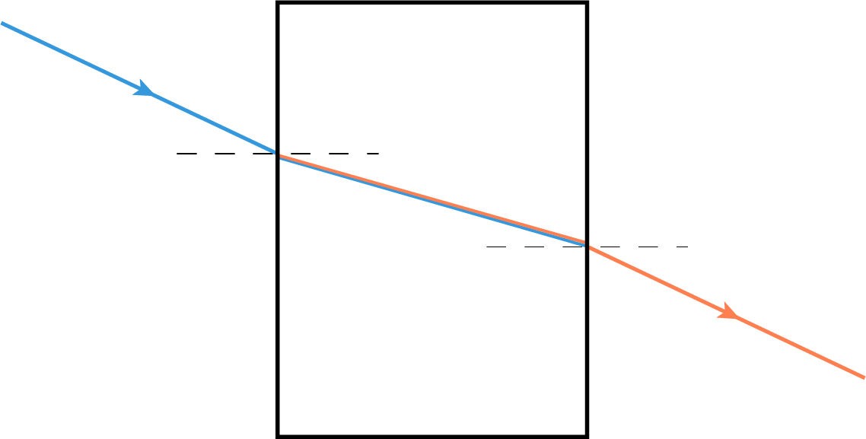
Why does this not occur with a rectangular prism?
Unlike in a triangular prism, in a rectangular prism the normal is at the same angle on both sides of the prism.
The light entering the prism refracts towards the normal. The colours all refract at different angles, but the difference is slight and not readily observable. And when the rays leave the prism, they refract away from the normal by exactly the same amount.
Thus, they are recombined into a beam of white light travelling out the other side of the prism at the same angle as they entered. In order for dispersion to occur, the angles at each side of the prism must be different.

